Slide 1


Virtual Wardrobe
Jayawant Shikshan Prasarak Mandal’s
JAYAWANTRAO SAWANT POLYTECHNIC
Department of INFORMATION TECHNOLOGY
“Your fitting room, anywhere.”

Slide 2
The Team Comprises
Eshita Atulkumar Bagade
Sonal Suryakant Sawant
Samruddhi Pradeep Repal
GUIDE
P.P.PATIL

Slide 3
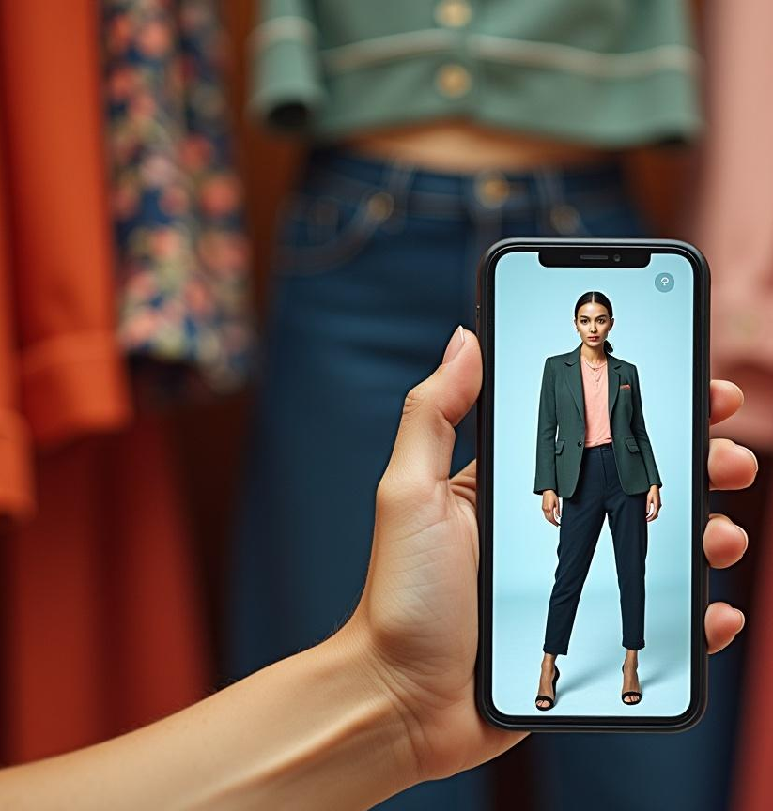
Title of Project
The project, titled "Virtual Wardrobe," aims to develop an interactive platform that uses advanced technologies to enhance the online clothing shopping experience.

Slide 4
Introduction
The AI-based virtual clothes trial mobile application is designed to enhance the online shopping experience by allowing users to try on clothes virtually.
-Brief about online shopping problems (size, fitting, returns).
-Need for a virtual trial system.
-Role of AI, AR (Augmented Reality), and Computer Vision in solving this.
-Objective: To provide customers with a realistic trial experience before purchase.
This introduction will explore the project's concept, objectives, and expected outcomes.

Slide 5

Technical Specifications

Slide 6
Information Related to Project
-Uses Machine Learning & Computer Vision for body measurement.
-Augmented Reality (AR) for live try-on.
-Integration with fashion e-commerce apps.
-Supports multiple clothes types (shirts, dresses, pants, etc.).
-Can enhance customer satisfaction & reduce product returns.

Slide 7
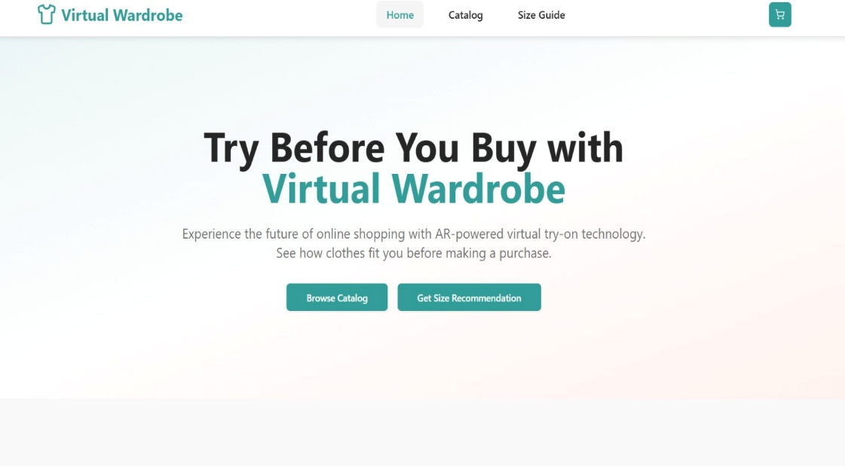
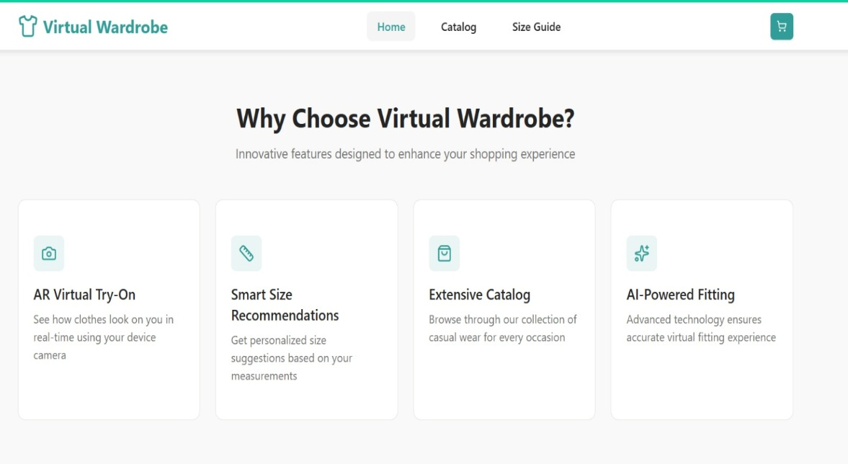
IMAGES

Slide 8
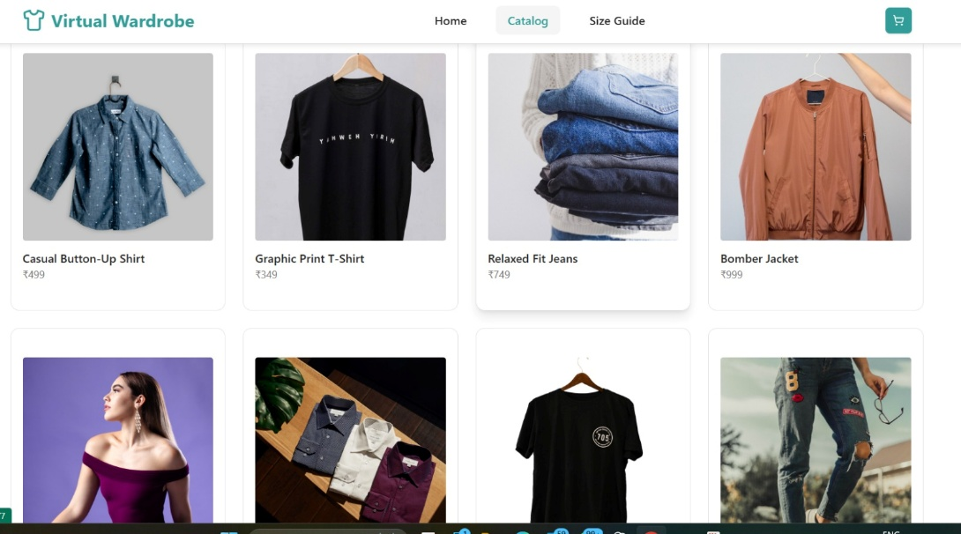
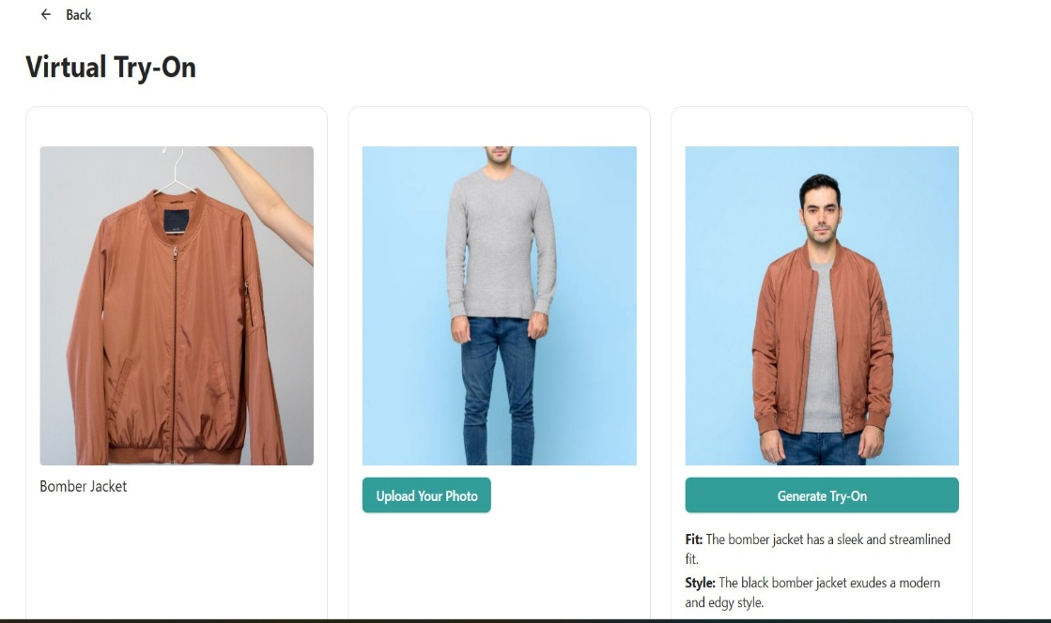

Slide 9
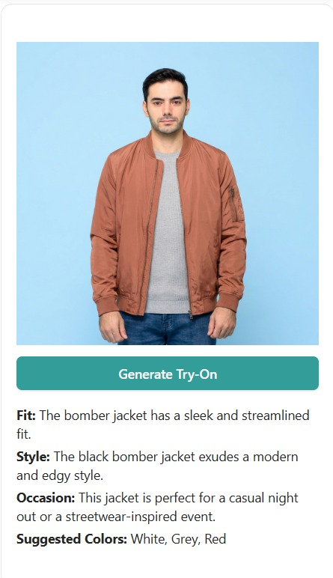
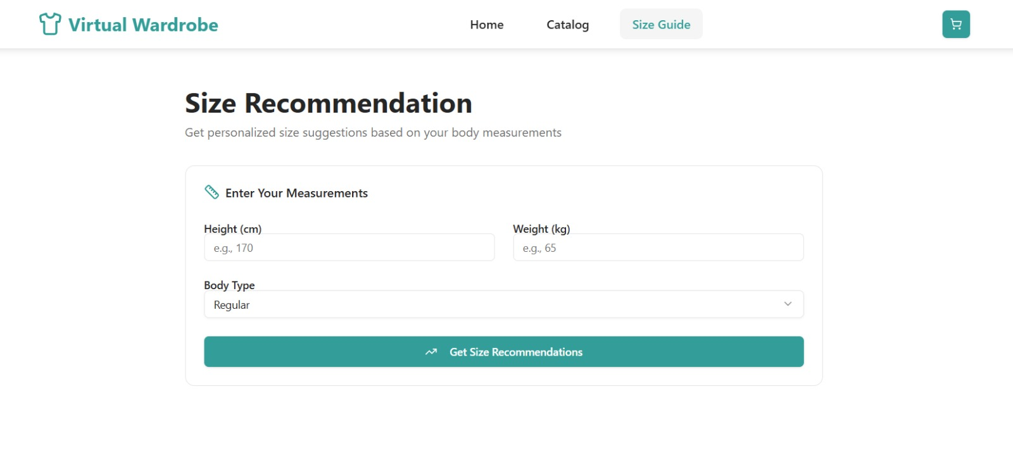

Slide 10
Future Scope
Enhanced Personalization – Provide outfit suggestions based on user’s body type, preferences, and past purchases.
Integration with E-commerce Platforms – Directly link with online stores for one-click buying after trying outfits virtually.
Multi-Brand & Global Access – Allow users to try clothes from multiple brands across the world in one app.
Virtual Wardrobe Creation – Users can save and mix outfits digitally to plan styles for different occasions.
Social Media Integration – Share virtual try-on looks with friends for feedback before purchase.

Slide 11

Conclusion
The AI-based virtual clothes trial mobile app is an important innovation in the retail industry. By using advanced technologies, it improves the shopping experience and helps solve common problems faced by online buyers. With future updates and feedback from users, the app will continue to improve and better meet market needs and expectations.

